Slide 1
Distributed Control and Automation Framework (DCAF)
Components
Instructor Name
Instructor's role
Notes:
People that contributed with this content:
Benjamin Celis
Mathew Pollock
Simon Perez
Andres Gomez

Slide 2
Agenda
Nomenclature
Overall Architecture Review
The Tag Bus
Engine Architecture
Module Architectures
The Configuration Editor Framework
Quiz
Notes:
Concepts covered in the next slides are similar to what is developed in the devguide Component Overview chapter:
https://github.com/LabVIEW-DCAF/Documentation/blob/master/Trunk/Getting%20Started%20Material/devguide/ch1_Component%20Overview.md

Slide 3
Nomenclature

Slide 4
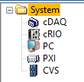

Nomenclature
Target: Computing hardware that executes a software application. The term ’Target’ is used in the LabVIEW project to identify where a LabVIEW VI will execute and within the DCAF Configuration Editor to contain one or more Engines.
Engine: State machine that executes Modules as defined in the Configuration Editor and provides a namespace for Tags. The Engine also passes data between its Modules according to its Mappings.
Notes:
Target: Computing hardware that executes a software application. The term ’Target’ is used in the LabVIEW project to identify where a LabVIEW VI will execute and within the DCAF Configuration Editor to contain one or more Engines.
Engine: State machine that executes Modules as defined in the Configuration Editor and provides a namespace for Tags. The Engine also passes data between its Modules according to its Mappings.

Slide 5

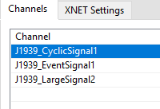
Nomenclature
Module: A collection of code of varying functionality that executes within an Engine and that can interact with the Tags of that Engine. Some standard Modules are installed with DCAF, but users can also create their own.
Channels: A Module’s input and output data which can be connected to Tags through Mappings. Channels are like Tags in that they are latest-value variables, except they are scoped to a specific Module and have a category based on how their data is exchanged with the engine (input, processing parameter, processing result, output).
Notes:
Module: A collection of code of varying functionality that executes within an Engine and that can interact with the Tags of that Engine. Some standard Modules are installed with DCAF, but users can also create their own.
Channels: A Module’s input and output data which can be connected to Tags through Mappings. Channels are like Tags in that they are latest-value variables, except they are scoped to a specific Module and have a category based on how their data is exchanged with the engine (input, processing parameter, processing result, output).

Slide 6
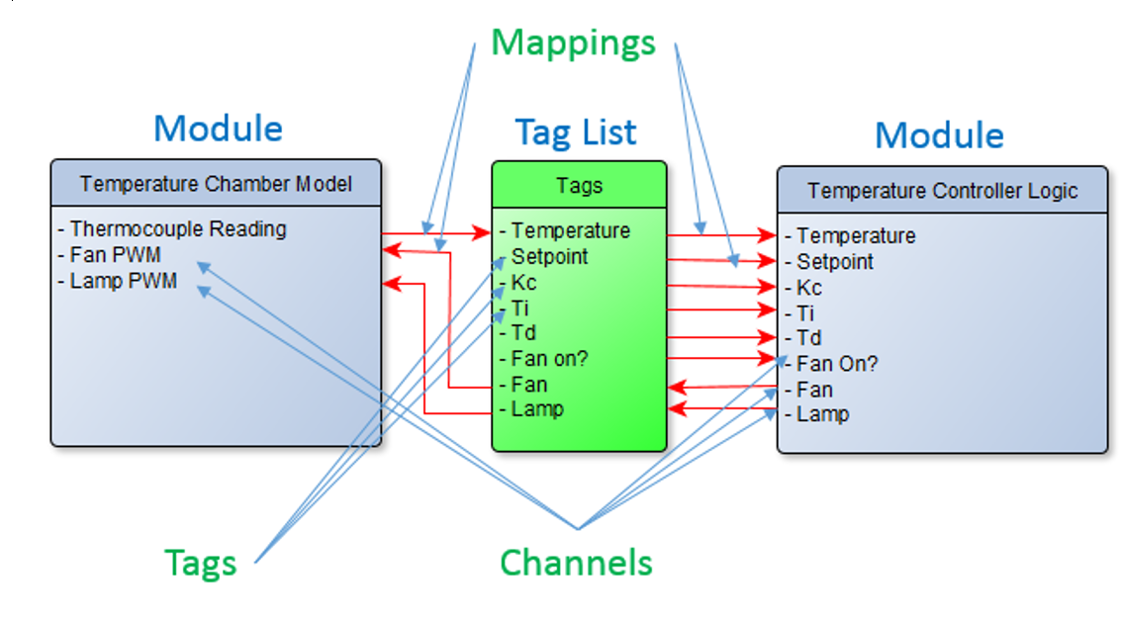
Nomenclature
Tags: Engine-scoped latest-value variables that can be accessed by any Module within that Engine. A Tag can be defined as a connecting point between Channels from different Modules. Each Tag must have a specified datatype and be given a name that is unique for its scope.
Mappings: Mappings are the connections between Tags and Channels. If you want a specific Channel to write or read a value on a specific Tag you will have to map them.
Notes:
Tags: Engine-scoped latest-value variables that can be accessed by any Module within that Engine. A Tag can be defined as a connecting point between Channels from different Modules. Each Tag must have a specified datatype and be given a name that is unique for its scope.
Mappings: Mappings are the connections between Tags and Channels. If you want a specific Channel to write or read a value on a specific Tag you will have to map them.

Slide 7
Overall Architecture Review

Slide 8
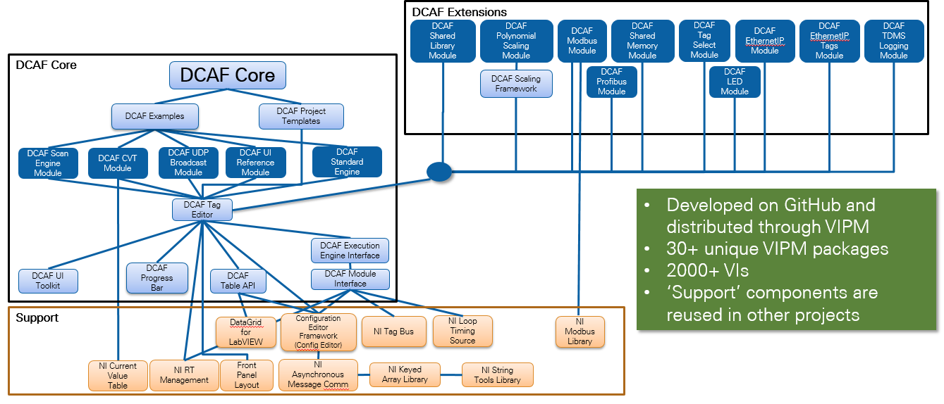
DCAF Package Dependency Diagram
Notes:
Review from intro
Useful for navigating Tools Network packages and GitHub Repos
The largest open source LabVIEW development project

Slide 9
DCAF Components
Project Templates
Configuration
Runtime
Templates
Configuration Editor
Engine
Examples
Modules
Notes:
Review from intro
From DevGuide
**Engine**: State machine that executes *Modules* as defined in the *Configuration Editor* and provides a namespace for *Tags*. The Engine also passes data between its *Modules* according to its *Mappings*.
**Module**: A collection of code of varying functionality that executes within an *Engine* and that can interact with the *Tags* of that *Engine*. Some standard *Modules* are installed with DCAF, but users can also create their own.
**Configuration Editor**: A LabVIEW program used to visually define the functionality of each *Engine* and *Module* in DCAF.

Slide 10
Tag Bus

Slide 11
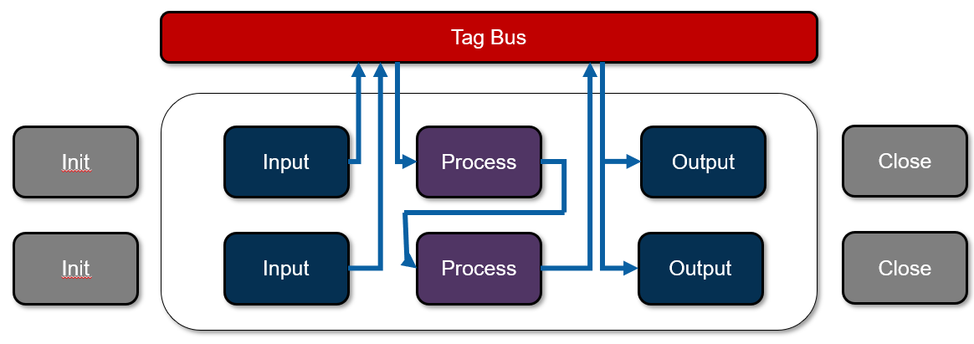
The Challenge of Sharing Data Efficiently
DCAF:
An open-source LabVIEW framework for creating configurable, latest value, data engines that can acquire data from multiple input sources, process that data, and then route it back to outputs or to data services.
How do we share this data?

Slide 12
Transferring Tags
Requirements
Flexibility
Scope
Performance
Current Options
Local Variable
Global Variable
Single Process Shared Variable
Functional Global Variable
Current Value Table (CVT)
Notes:
DCAF was designed for systems in which the main data transfer is tags.
LabVIEW offers many options to manage tags.
But for design we had 3 main guidelines and they could not be achieved with the current options.
What's the need?
Limited Solutions:
Variables
CVT
Scope
Data Types

Slide 13

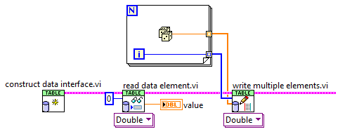
Tag Bus
CVT on the wire
Controlled Scope
Data Protection
Fast
Reduced memory copies
Filtering

Slide 14
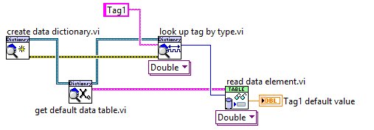
Tag Bus - Data Dictionary

Slide 15
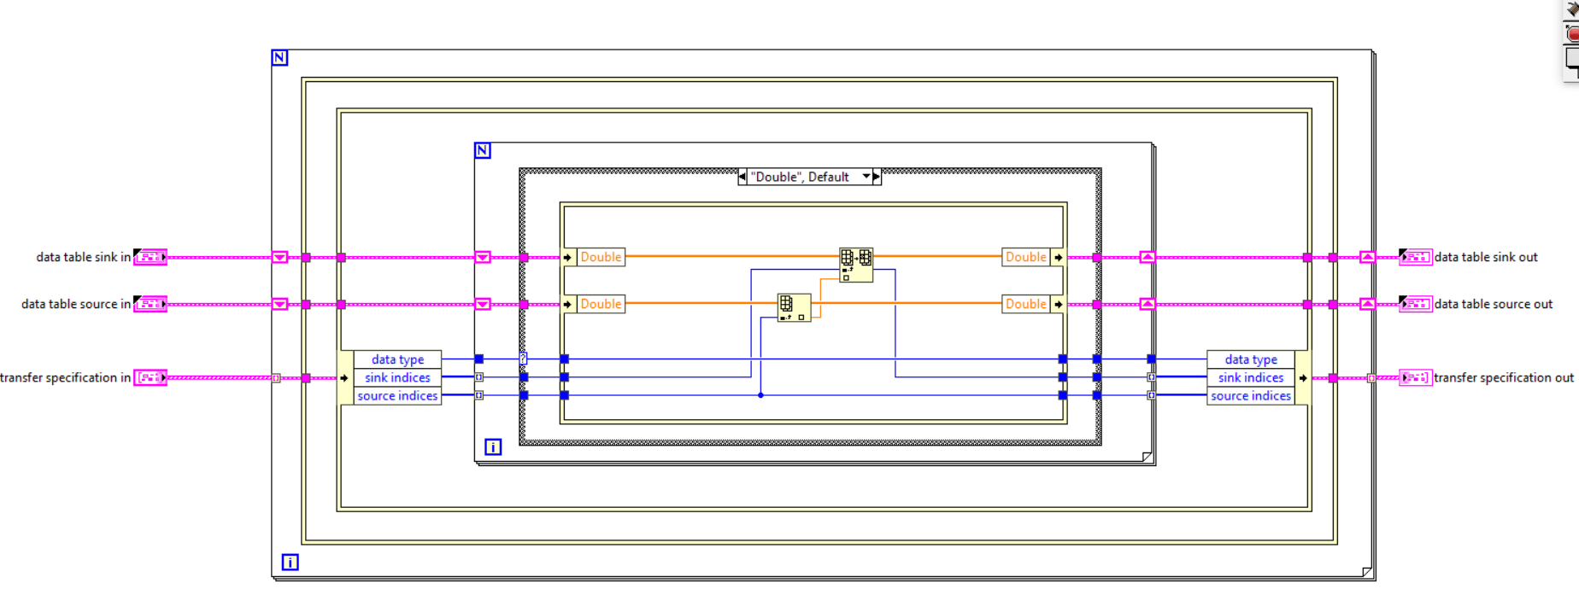
Tag Bus - Duplication
Notes:
Major issue with clustersauruses: data copies of the cluster and accidentally stomping on data, especially if sending the whole cluster into every user of the cluster
Solution: break up the cluster such that each user of the cluster gets the minimum data set it needs and prevent useless data copies when getting/setting the values from the main cluster
Each DCAF module gets a “mini” tag bus containing only the data used by that module. Scripting templates take care of all data access operations on the mini-tag bus in the module for most common use cases.
Use of in-place operations, plus never branching the main tag bus wire, prevent copies of the main cluster

Slide 16
Engine

Slide 17
DCAF Engine
Engine
Init
Input
Process
Output
Close
Input
Process
Output
Input
Process
Output
Outside
Outside?
Outside
Editor
Engine
Modules
Notes:
The DCAF Engine takes care of initiailizing, running and closing the modules set up by the Editor. Each module will have an Init, some kind of runtime behavior (Input, Process, Output, or some combination thereof) and Close.
Note that the Input modules are al called first, then all the process modules, and finally all the output modules. Let’s look at a simplified version of what the engine is running

Slide 18
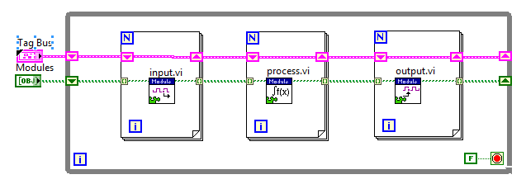
DCAF Engine - Simplified
Editor
Engine
Modules
Notes:
A simplified look at the engine.
The engine calls all the modules’ Input VIs, then all the Process VIs, and finally all the Output VIs.

Slide 19
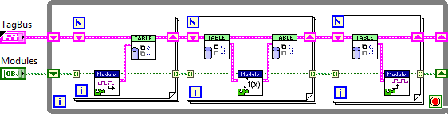
DCAF Engine - Simplified
Editor
Engine
Modules
Notes:
A slightly less simplified look now that demonstrates that the modules do not talk to each other directly. Instead, each one reads and writes to the Tag Bus table. The Tag Bus then ferries the data to the other modules.

Slide 20
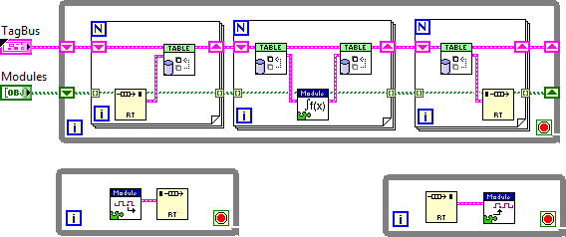
DCAF Engine - Asynchronous Modules
Editor
Engine
Modules
Notes:
While all modules are called in order, they do not all need to execute fully if they are marked as Asynchronous. Instead, the engine creates an extra loop and an RT FIFO – when the engine gets to calling the particular method it reads and writes to an RT FIFO instead

Slide 21

Engine Execution Model
DCAF Execution Engine
Run State
Shutdown
Idle
Tag Bus
Inputs
Process
Outputs
Upkeep
Wait
Configuring
Plugin1
Plugin3
Plugin1
Fault Recovery
Plugin2
Plugin4
Plugin5
House-Keeping
Safe State

Slide 22
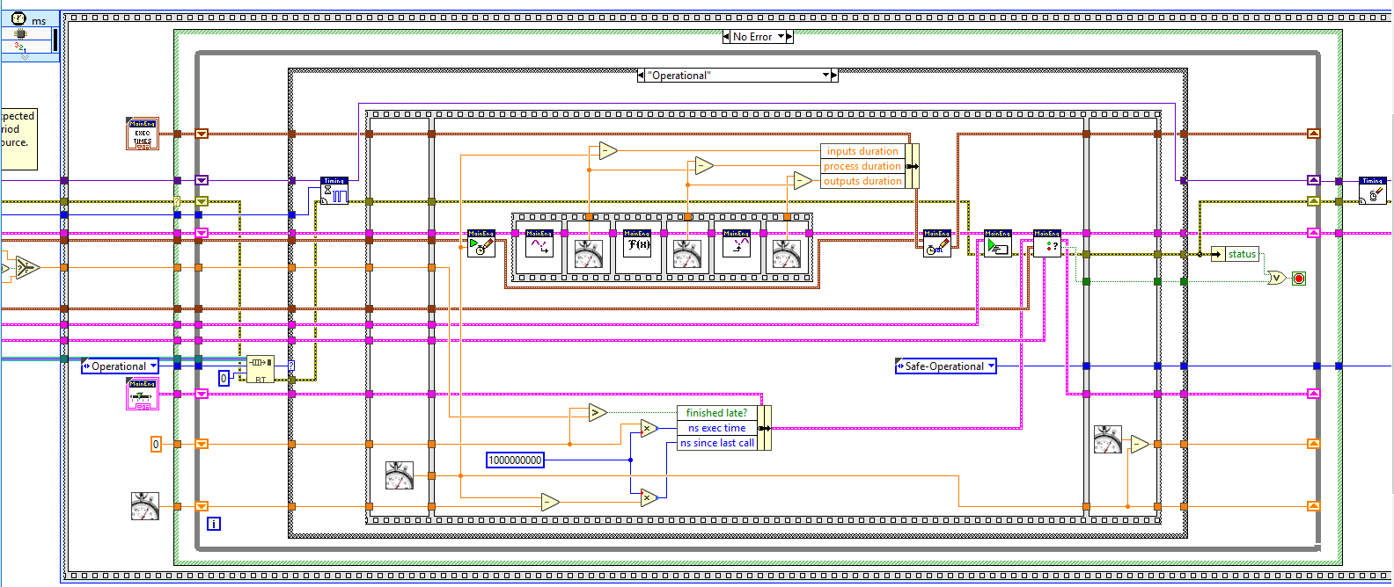
DCAF Engine - Execution
Editor
Engine
Modules
Notes:
The source code for the engine isn’t as scary as you might think. It follows a pretty straightforward sequence of steps:
Check for a message to stop.
Wait for next clock source to fire.
Sequentially read all inputs and store data on the bus.
Process data and store on bus, then process again and store on the bus, then process again. Etc.
Send data to all output locations sequentially.
Choose which plugins execute on the next iteration.
Check for errors and handle them.
Sequential execution provides predictable behavior.
C:\Program Files (x86)\National Instruments\LabVIEW 2017\vi.lib\NI\DCAF\Engines\Standard Engine\Execution Engine\main engine\primary control loop.vi

Slide 23
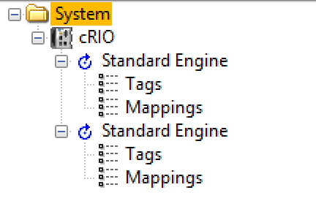
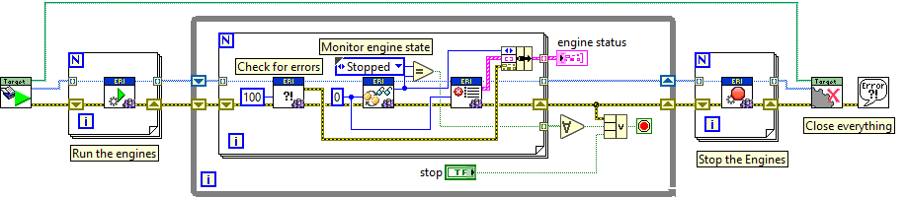
DCAF Execution Engine Interface
Can execute multiple engines at the same time
Each Engine is a different thread
Engine controls modules execution and data transfer
Provides API to control and get access to the engines

Slide 24
DCAF Engine - Execution Interface
Can execute multiple engines at the same time
Each Engine is a different thread
Engine controls modules execution and data transfer
Provides API to control and get access to the engines
Editor
Engine
Modules

Slide 25
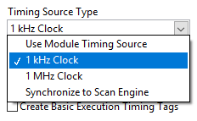
Timing the Engine
Chosen within the configuration editor.
Uses the Loop timing Source API
Custom timing sources can be added by overriding timing source API method

Slide 26
DCAF Engine - Asynchronous Modules
Editor
Engine
Modules
Notes:
While all modules are called in order, they do not all need to execute fully if they are marked as Asynchronous. Instead, the engine creates an extra loop and an RT FIFO – when the engine gets to calling the particular method it reads and writes to an RT FIFO instead

Slide 27
Asynchronous Module
Engine
Engine
Wait 0 ms on Input Buffer
Get DVR
Polling
Lock DVR
Transfer Data
Write DVR to
Command FIFO
Polling
Modules
Async Worker
Wait -1 on Command FIFO
Get DVR
Blocking
Lock DVR
Run Module Input
Write DVR to
Input Buffer
Blocking
Editor
Engine
Modules
Notes:
There is no data transfer, the only thing we are transferring is the DVR. We are using the FIFOs as a arbitration mechanism to protect the DVR. This is required because DVR, will always block and there are no timeouts.

Slide 28
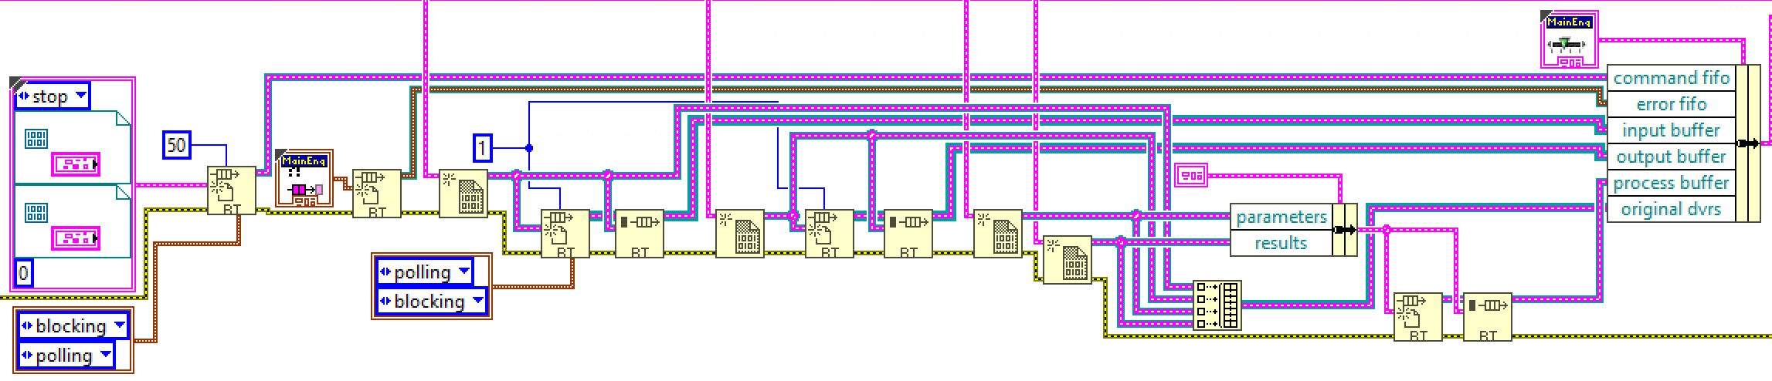

Asynchronous Modules
Creates DVRs
Creates RT FIFOs
Command FIFO
Input, Output and Process Buffer
Launches Asynchronous Worker
Editor
Engine
Modules
Notes:
C:\Program Files (x86)\National Instruments\LabVIEW 2018\vi.lib\NI\DCAF\Engines\Standard Engine\Execution Engine\async executor\start async worker.vi

Slide 29
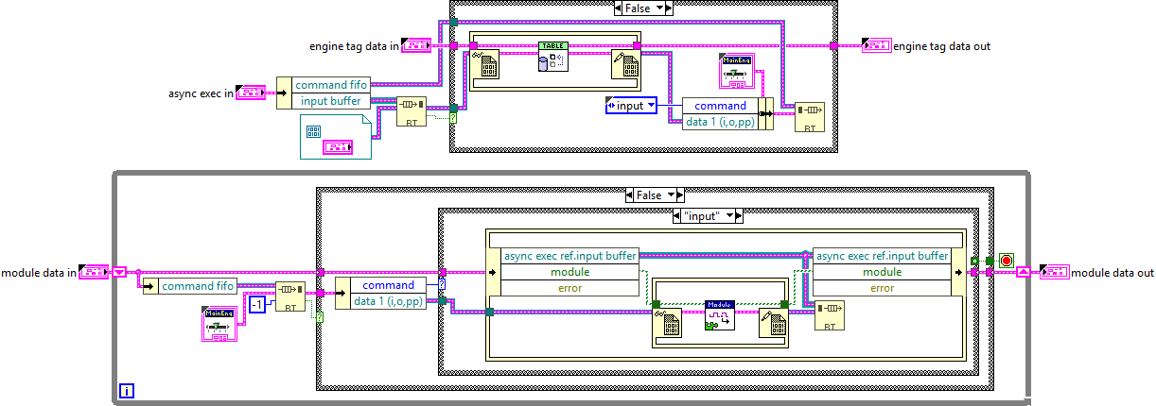
Asynchronous Module
Editor
Engine
Modules
Notes:
C:\Program Files (x86)\National Instruments\LabVIEW 2018\vi.lib\NI\DCAF\Engines\Standard Engine\Execution Engine\async executor\async input data method.vi
C:\Program Files (x86)\National Instruments\LabVIEW 2018\vi.lib\NI\DCAF\Engines\Standard Engine\Execution Engine\async executor\async worker process.vi

Slide 30
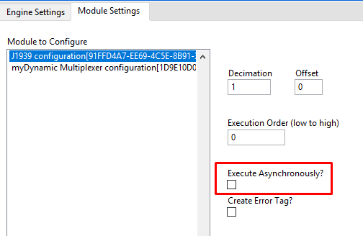
DCAF Engine - Asynchronous Modules
Editor
Engine
Modules
Notes:
The good news is that we can have modules running async by checking this box and the engine will take care of it for us

Slide 31
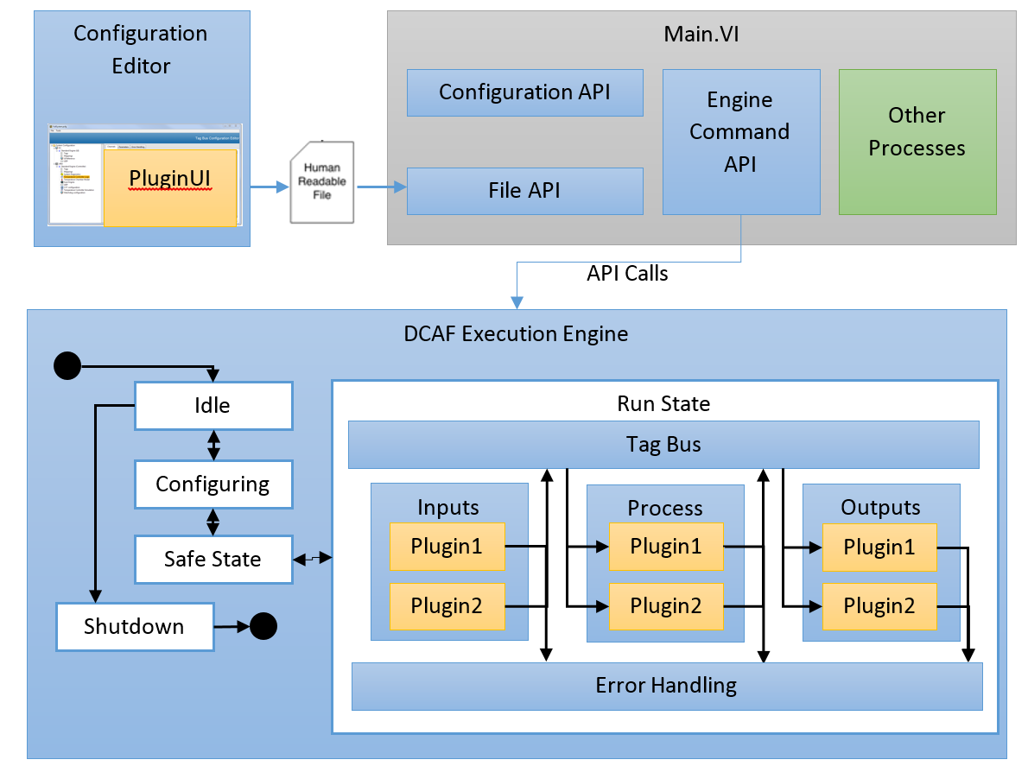
DCAF Engine
Blue: Provided out of the box
Yellow: Modules to customize behavior
Green: Parallel to the framework
Editor
Engine
Modules
Notes:
But what exactly is provided out of the Box?
The Engine runs the modules as we have previously seen, but this requires no direct user programming. Instead
State machine with a safe state
Sequentially executes Input, Process, and Output methods of each plugin
Passes latest value data between plugins
Configurable execution timing
Built-in error reporting and recovery
Prevent Race conditions, memory allocations, thread starvation, etc.

Slide 32
Modules

Slide 33
Module Components
Configuration
Editor node
Runtime
Editor Node
User interface
Runs on PC
Creates or modifies the configuration
Contains the configuration class
Editor
Engine
Modules

Slide 34
Module Components
Configuration
Editor node
Runtime
Runtime Node
Initializes runtime based on configuration
Provides execution logic
Editor
Engine
Modules

Slide 35
Module Components
Configuration
Editor node
Runtime
Configuration
Created on PC, passed to runtime system
Provides data access and serialization/deserialization methods
Data storage only, no editor or runtime logic
Editor
Engine
Modules

Slide 36
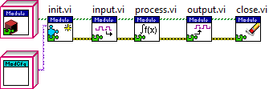
Module Runtime
Editor
Engine
Modules

Slide 37
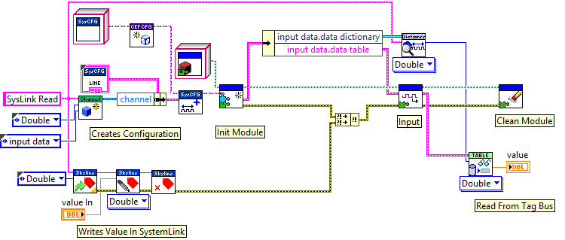
Module Runtime Test Harness Example
Editor
Engine
Modules
Notes:
Add compare between expected and read values to demo test

Slide 38
What is the module doing?
Engine
Input
Process
Output
Outside
Outside
Outside
Editor
Engine
Modules

Slide 39
What is the module doing?
Editor
Engine
Modules
Notes:
We want to highlight that modules interact with channels and these are connected to engine tags through mappings. Modules can bring information from the outside to the engine, from the engine to the outside or both.

Slide 40
Static Module
Configuration Class
Select module options (number of instances, allowable targets)
Update validate.vi with validation rules
Update get default error list.vi with default error classifications
Editor Class
Select module glyph
Runtime
Implement User Input.vi, User Process.vi, and/or User Output.vi with custom logic
Editor
Engine
Modules
Notes:
Differences between static and dynamic modules will be studied later

Slide 41
Dynamic Module
Configuration:
Add parameters to the Window
Add parameters to Configuration Class
Implement To and From String
Editor Class
Define Lines to tie Channel information to Module behaviour
Runtime
Implement User Input.vi, User Process.vi, and/or User Output.vi with custom logic
Editor
Engine
Modules

Slide 42
Configuration Editor

Slide 43
Configuration Editor Framework (CEF)
Configure targets, engines and modules.
Maintains list of tags and their mappings with modules.
Each module provide its configuration window.
Configuration is saved into XML file with .pcfg extension.
Editor
Engine
Modules
Notes:
Configure the multiple targets that are part of a DCAF system, to add engines to each target and a series of modules within that engine.
Maintains a list of the tags in the system and how they map to the channels in the different modules. It also provides features such as automapping and displaying a summary of the system configuration.
Shows a hierarchical view of a DCAF system on the left tree and information on the selected item on the right window; these configurations can be saved and loaded through the File menu.
Each module has its own configuration window, populated by the module itself.
The Engine and target itself also have configuration windows. The engine has its name, assignment to a processor, as well as Timing Source, while the target has the type (Linux RT ARM, Linux RT x64, Windows, etc), FPGA settings if available, and deployment settings.
Having configured the system, the configuration itself must be saved, exported as a .pcfg file and deployed to every target system. At runtime, the file is used by an application to instantiate and configure all the modules before beginning execution.

Slide 44
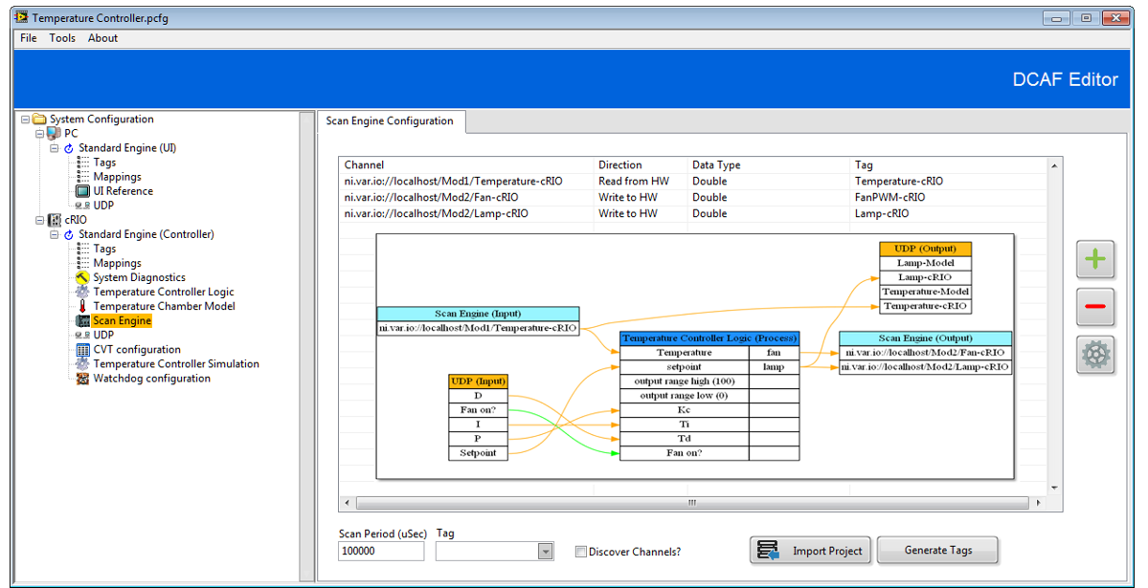
Configuration Editor Framework (CEF)
Editor
Engine
Modules
Notes:
Configure the multiple targets that are part of a DCAF system, to add engines to each target and a series of modules within that engine.
Maintains a list of the tags in the system and how they map to the channels in the different modules. It also provides features such as automapping and displaying a summary of the system configuration.
Shows a hierarchical view of a DCAF system on the left tree and information on the selected item on the right window; these configurations can be saved and loaded through the File menu.
Each module has its own configuration window, populated by the module itself.
The Engine and target itself also have configuration windows. The engine has its name, assignment to a processor, as well as Timing Source, while the target has the type (Linux RT ARM, Linux RT x64, Windows, etc), FPGA settings if available, and deployment settings.
Having configured the system, the configuration itself must be saved, exported as a .pcfg file and deployed to every target system. At runtime, the file is used by an application to instantiate and configure all the modules before beginning execution.

Slide 45
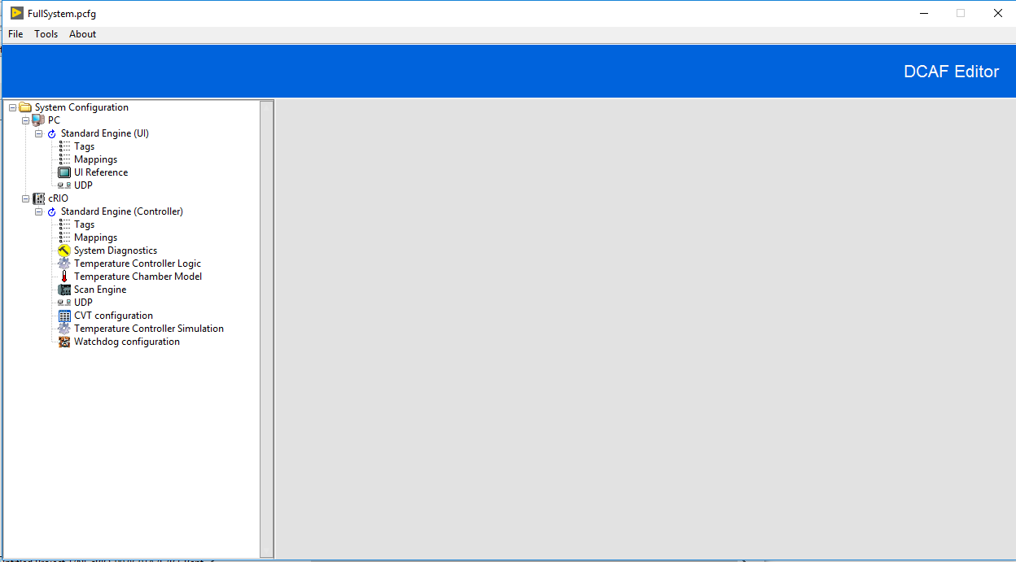
Configuration Editor Framework (CEF)
Open Source Library
Tools to manage tree control and subpanels
Can be extended and customized
3 starting templates available
Editor
Engine
Modules

Slide 46

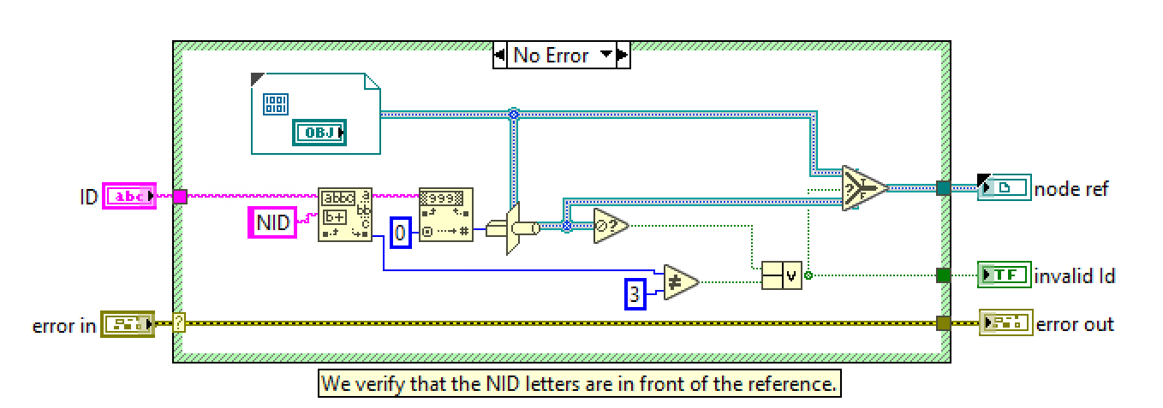
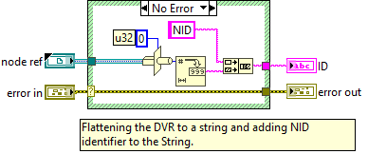

Text to objects DVR
This Feature is from CEF (Configuration Editor Framework)
Allows accessing objects from a string store on a tree

Slide 47
Quiz

Slide 48
Relate the statements with the concept that best matches
Inputs and outputs of a module
Hardware that runs DCAF Engine
Last value data contained in the engine
Connection between data provided by modules and data in the engine
State machine that shares data among several modules
Tags
Channels
Engine
Mappings
Target

Slide 49
Relate the statements with the concept that best matches
Inputs and outputs of a module
Hardware that runs DCAF Engine
Last value data contained in the engine
Connection between data provided by modules and data in the engine
State machine that shares data among several modules
Tags
Channels
Engine
Mappings
Target

Slide 50
The DCAF Engine relies on the Current Value Table (CVT) API to implement and share its internal tags between modules
A. True
B. False. Tag Bus is used for this purpose. CVT is not supported in DCAF at all.
C. False. Tag Bus is used for this purpose. CVTs exist as a module.
Notes:
C

Slide 51
The DCAF Engine relies on the Current Value Table (CVT) API to implement and share its internal tags between modules
A. True
B. False. Tag Bus is used for this purpose. CVT is not supported in DCAF at all.
C. False. Tag Bus is used for this purpose. CVTs exist as a module.
Notes:
C

Slide 52
Which of the next are actions executed by the DCAF Engine?
Waits for configured timing source to fire to synchronize its execution.
Reds inputs from all the modules sequentially.
Allows all the modules to do their processing in parallel.
Checks for the presence of errors and handles them.
Creates an XML file with the settings configured by the user.
Notes:
A, B and D

Slide 53
Which of the next are actions executed by the DCAF Engine?
Waits for configured timing source to fire to synchronize its execution.
Reds inputs from all the modules sequentially.
Allows all the modules to do their processing in parallel.
Checks for the presence of errors and handles them.
Creates an XML file with the settings configured by the user.
Notes:
A, B and D

Slide 54
What file extension is generated by the DCAF Editor?
.dcaf
.dcafconf
.pcfg
.ecfg
Notes:
C

Slide 55
What file extension is generated by the DCAF Editor?
.dcaf
.dcafconf
.pcfg
.ecfg
Notes:
C

Slide 56
Resources

Slide 57
Resources
DCAF Developer Guide:
Chapter 1: Components Overview
Notes:
https://github.com/LabVIEW-DCAF/Documentation/blob/master/Trunk/Getting%20Started%20Material/devguide/ch1_Component%20Overview.md

